Slide 1
CSC 2114: Artificial Intelligence
Search
Notes:
Please retain proper attribution, including the reference to ai.berkeley.edu. Thanks!

Slide 2
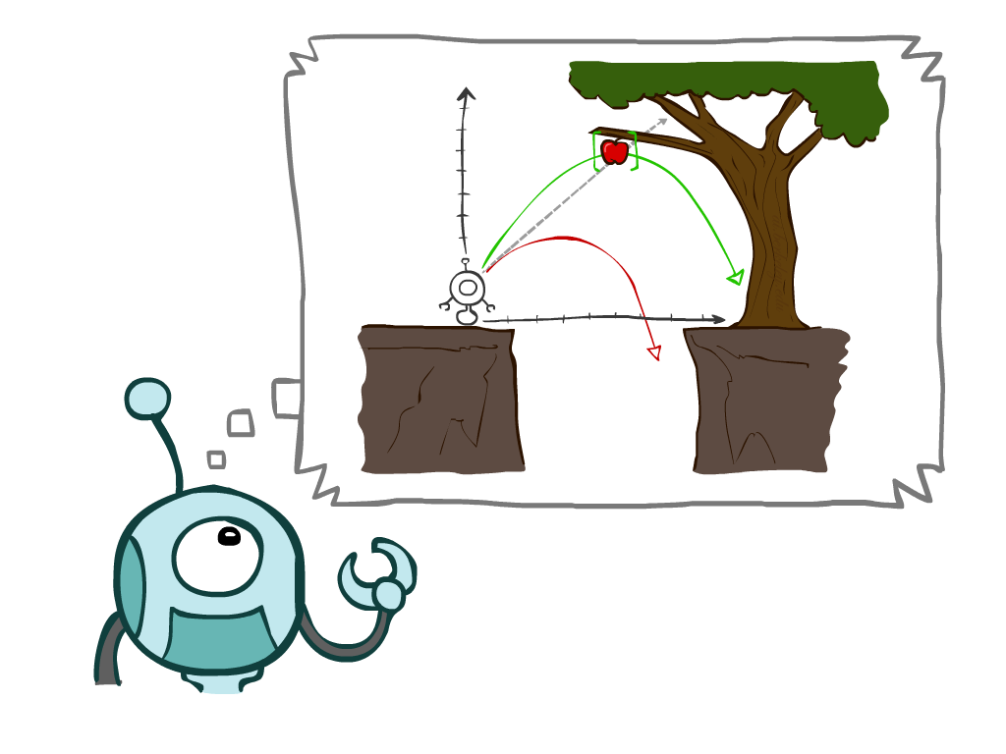
Today
Agents that Plan Ahead
Search Problems
Uninformed Search Methods
Depth-First Search
Breadth-First Search
Uniform-Cost Search
Notes:
General theme in the class:
A goal we have in mind.
A mathematical abstraction to formalize this
Algorithms that operate on these abstractions

Slide 3

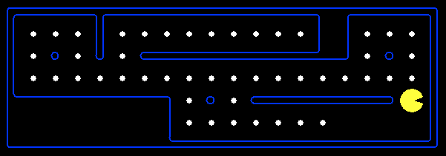
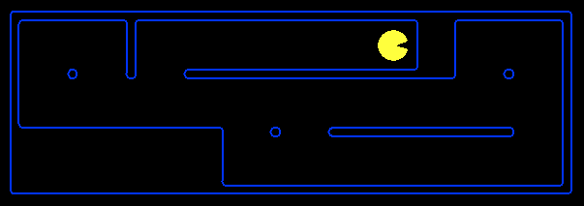
Planning Agents
Planning agents decide based on evaluating future action sequences
Must have a model of how the world evolves in response to actions
Usually have a definite goal
Optimal: Achieve goal at least cost

Slide 4

Search Problems

Slide 5







Search Problems
A search problem consists of:
A state space: S
An initial state: s₀
Actions: A(s) in each state
Transition model: Result(s,a)
A goal test: G(s)
S has no dots left
Action cost c(s,a,s’)
A solution is an action sequence that reaches a goal state
An optimal solution has least cost among all solutions
N
-9
E
-9
Notes:
Often comes back on exams
Goal test – sometimes more than one state that satisfies having achieved the goal, for example, “eat all the dots”
Abstraction

Slide 6

Search Problems Are Models

Slide 7
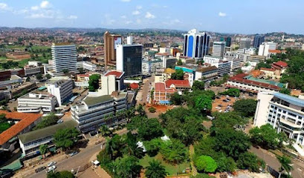
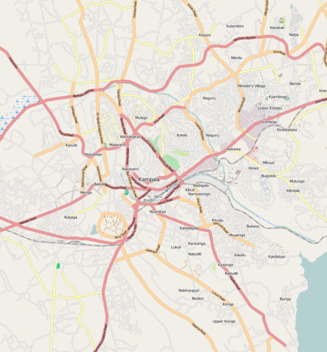
Example: Traveling in Kampala

Slide 8
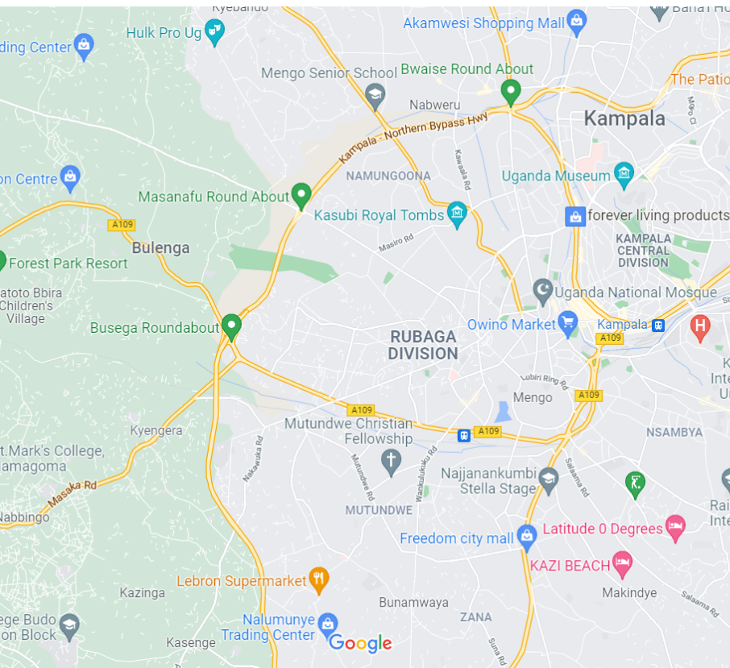
Example: Traveling in Kampala
State space:
Towns
Initial state:
Owino market
Actions:
Go to adjacent Towns
Transition model:
Reach adjacent Towns
Goal test:
s = Kasubi Royal Tombs?
Action cost:
Road distance from s to s’
Solution?

Slide 9
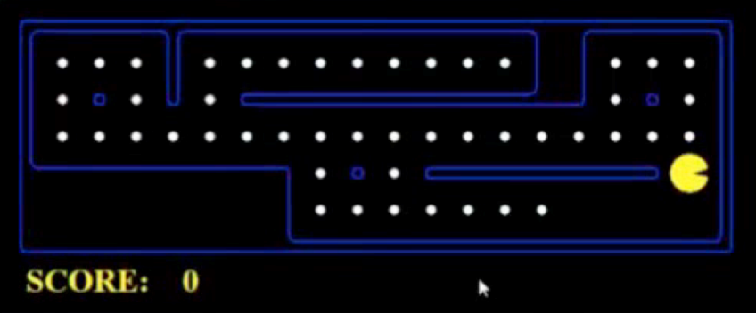
What’s in a State Space?
The world state includes every last detail of the environment
A search state keeps only the details needed for planning (abstraction)
Problem: Pathing
States: (x,y) location
Actions: NSEW
Transition: update x,y value
Goal test: is (x,y)=destination
Problem: Eat-All-Dots
States: {(x,y), dot Booleans}
Actions: NSEW
Transition: update x,y and possibly a dot Boolean
Goal test: dots all false
Notes:
Wrong example for “eat-all-dots”: (x, y, dot count)

Slide 10

State Space Graphs and Search Trees

Slide 11
State Space Graphs
State space graph: A mathematical representation of a search problem
Nodes are (abstracted) world configurations
Arcs represent transitions (labeled with actions)
The goal test is a set of goal nodes (maybe only one)
In a state space graph, each state occurs only once!
We can rarely build this full graph in memory (it’s too big), but it’s a useful idea

Slide 12
State Space Graphs
State space graph: A mathematical representation of a search problem
Nodes are (abstracted) world configurations
Arcs represent successors (action results)
The goal test is a set of goal nodes (maybe only one)
In a state space graph, each state occurs only once!
We can rarely build this full graph in memory (it’s too big), but it’s a useful idea
a
G
b
c
e
d
f
S
h
p
q
r
Tiny state space graph for a tiny search problem

Slide 13
State Space Graphs vs. Search Trees
State Space Graph
Each NODE in in the search tree is an entire PATH in the state space graph.
Search Tree
S
a
G
d
e
p
b
c
q
b
c
e
h
r
d
e
f
a
a
h
r
p
q
f
S
h
We construct the tree on demand – and we construct as little as possible.
p
q
f
q
c
G
p
q
r
q
c
G
a
a

Slide 14

Quiz: State Space Graphs vs. Search Trees
Consider this 4-state graph:
How big is its search tree (from S)?
a
S
G
b

Slide 15
Quiz: State Space Graphs vs. Search Trees
Consider this 4-state graph:
How big is its search tree (from S)?
a
s
a
b
S
G
b
G
a
G
b
a
G
b
G
…
…
Important: Those who don’t know history are doomed to repeat it!

Slide 16
Quiz: State Space Graphs vs. Search Trees
Consider a rectangular grid:
How many states within d steps of start?
How many states in search tree of depth d?

Slide 17
Tree Search

Slide 18
Search Example: Romania
Start
Destination

Slide 19
Creating the search tree

Slide 20
Creating the search tree

Slide 21
Creating the search tree

Slide 22
General Tree Search
Main variations:
Which leaf node to expand next
Whether to check for repeated states
Data structures for frontier, expanded nodes

Slide 23
Systematic search
frontier
expanded
reached =
expanded U frontier
unexplored
Frontier separates expanded from unexplored region of state-space graph
Expanding a frontier node:
Moves a node from frontier into expanded
Adds nodes from unexplored into frontier, maintaining property 1

Slide 24
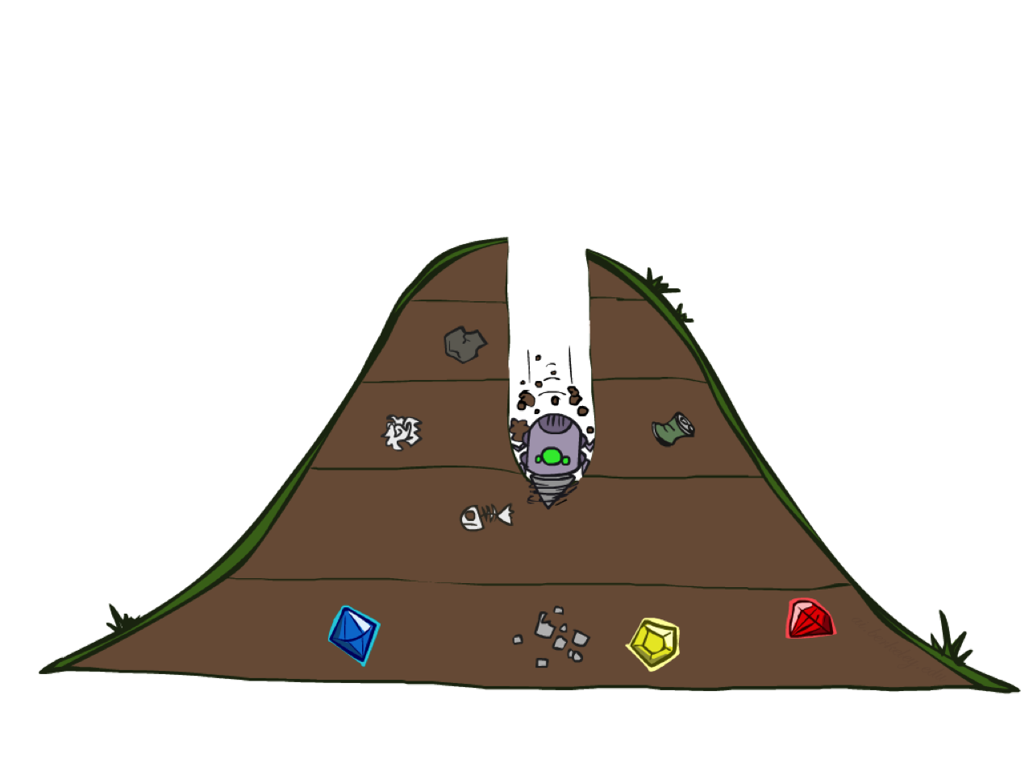
Depth-First Search

Slide 25
Depth-First Search
Strategy: expand a deepest node first
Implementation: Frontier is a LIFO stack
a
G
a
c
b
c
b
e
d
e
d
f
f
S
h
h
p
p
r
q
r
q
S
d
e
p
b
c
e
h
r
q
a
a
h
r
p
q
f
p
q
f
q
c
G
q
c
G
a
a

Slide 26
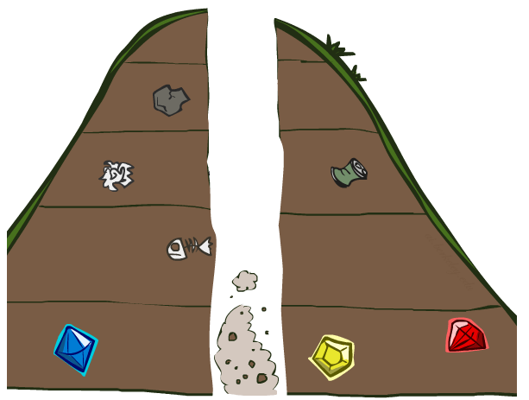
Search Algorithm Properties

Slide 27
Search Algorithm Properties
Complete: Guaranteed to find a solution if one exists?
Optimal: Guaranteed to find the least cost path?
Time complexity?
Space complexity?
Cartoon of search tree:
b is the branching factor
m is the maximum depth
solutions at various depths
Number of nodes in entire tree?
1 + b + b² + …. b^{m} = O(b^{m})
1 node
b
…
b nodes
b² nodes
m tiers
b^{m} nodes

Slide 28
Depth-First Search (DFS) Properties
What nodes does DFS expand?
Some left prefix of the tree down to depth m.
Could process the whole tree!
If m is finite, takes time O(b^{m})
How much space does the frontier take?
Only has siblings on path to root, so O(bm)
Is it complete?
m could be infinite
preventing cycles may help (more later)
Is it optimal?
No, it finds the “leftmost” solution, regardless of depth or cost
1 node
b
…
b nodes
b² nodes
m tiers
b^{m} nodes

Slide 29
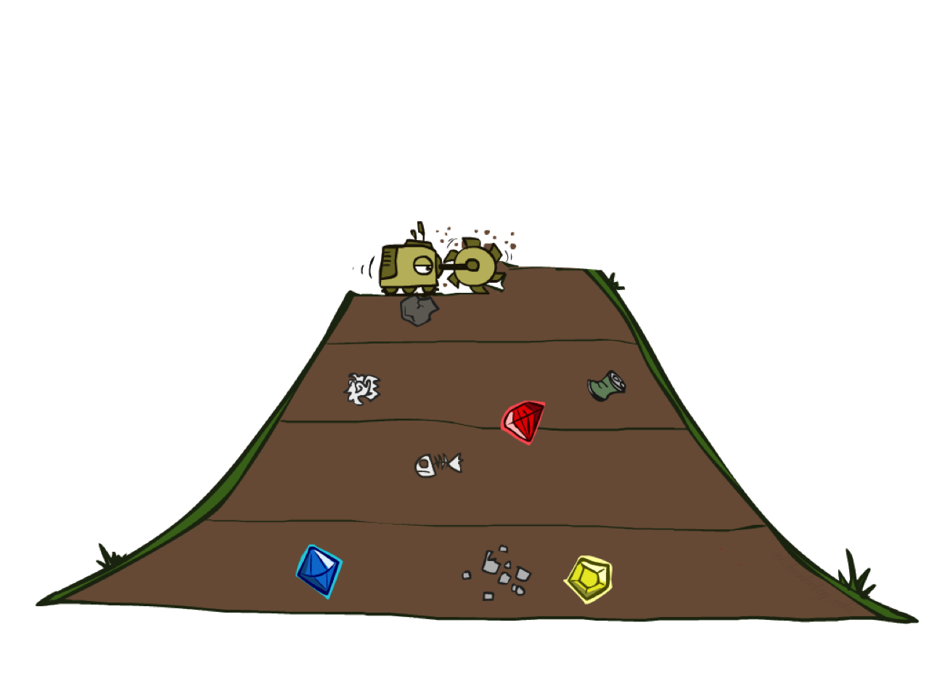
Breadth-First Search

Slide 30
Breadth-First Search
Strategy: expand a shallowest node first
Implementation: Frontier is a FIFO queue
a
G
b
c
d
e
f
S
h
p
q
r
S
d
e
p
Search
Tiers
b
c
e
h
r
q
a
a
h
r
p
q
f
p
q
f
q
c
G
q
c
G
a
a

Slide 31
Breadth-First Search (BFS) Properties
What nodes does BFS expand?
Processes all nodes above shallowest solution
Let depth of shallowest solution be s
Search takes time O(b^{s})
How much space does the frontier take?
Has roughly the last tier, so O(b^{s})
Is it complete?
s must be finite if a solution exists, so yes!
Is it optimal?
If costs are equal (e.g., 1)
1 node
b
…
b nodes
s tiers
b² nodes
b^{s} nodes
b^{m} nodes

Slide 32
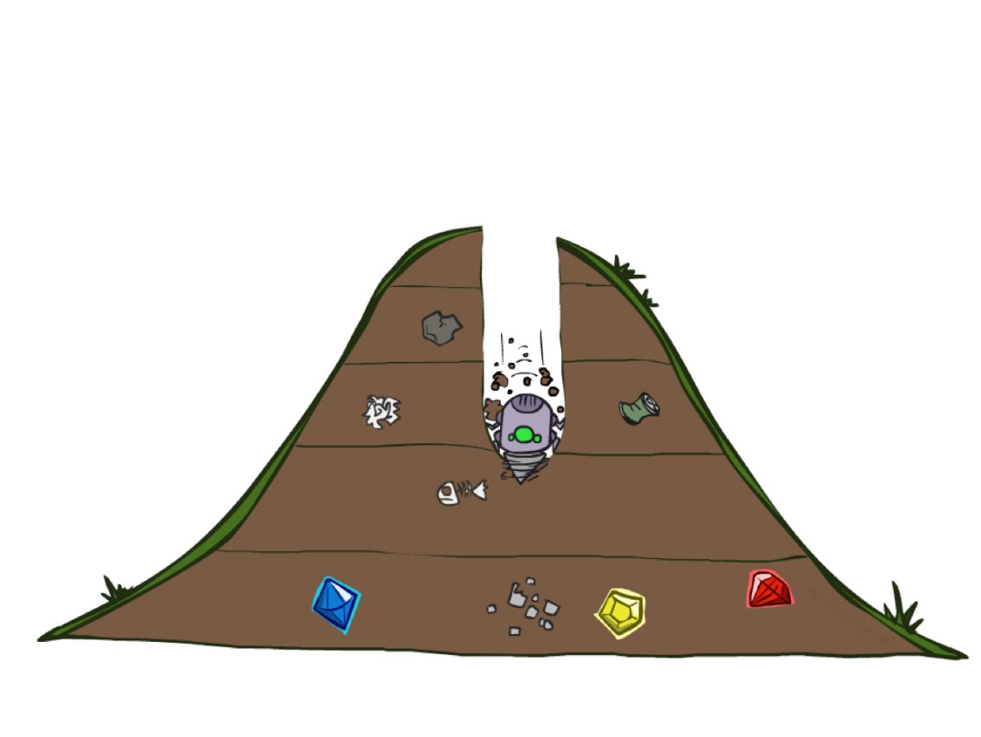
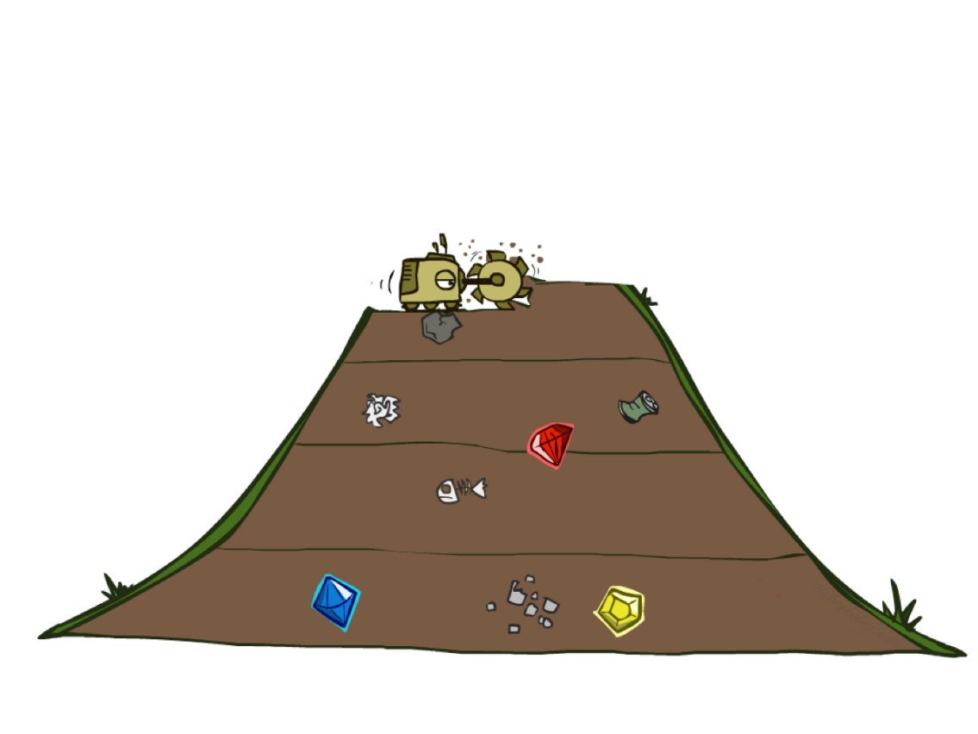
Quiz: DFS vs BFS

Slide 33
Quiz: DFS vs BFS
When will BFS outperform DFS?
When will DFS outperform BFS?
Notes:
BFS best when there is a shallow solution, s << m
DFS best when solutions all at m, and fairly common at m

Slide 34
Iterative Deepening
Idea: get DFS’s space advantage with BFS’s time / shallow-solution advantages
Run a DFS with depth limit 1. If no solution…
Run a DFS with depth limit 2. If no solution…
Run a DFS with depth limit 3. …..
Isn’t that wastefully redundant?
Generally most work happens in the lowest level searched, so not so bad!
b
…
Notes:
1 + (1+b) + (1+b+b²) + … + (1+b+…+b^{s}) = (s+1) + sb + (s-1)b² + … + b^{s} = O(b^{s})

Slide 35
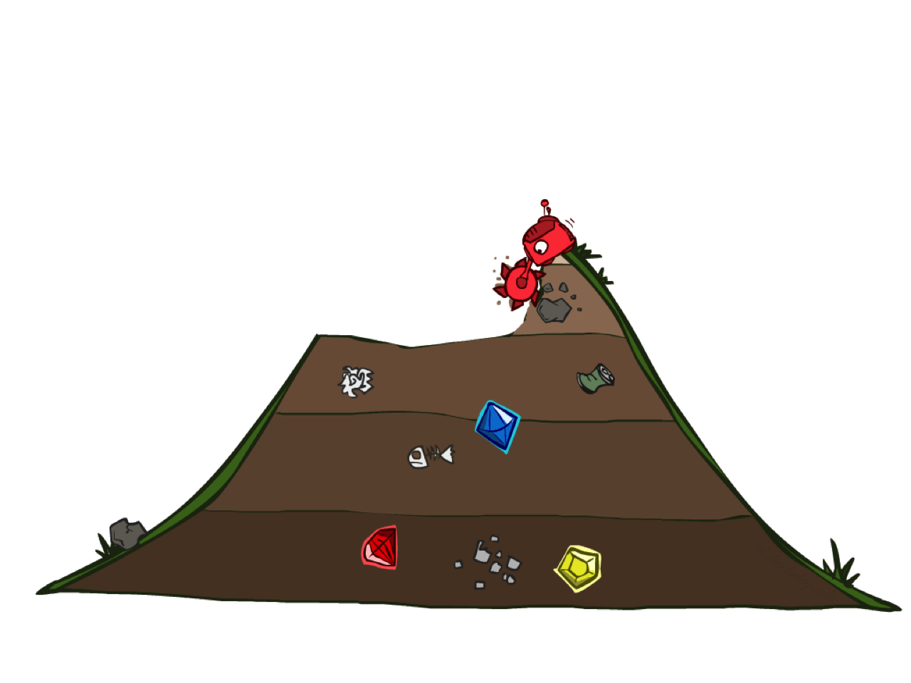
Uniform Cost Search

Slide 36
Uniform Cost Search
2
G
a
g(n) = cost from root to n
Strategy: expand lowest g(n)
Frontier is a priority queue sorted by g(n)
b
c
1
8
2
2
e
3
d
f
9
8
2
S
h
1
1
p
q
r
15
0
S
d
3
e
9
p
1
b
4
e
5
h
17
r
11
q
16
c
11
Cost contours
a
6
a
h
13
r
7
p
q
f
p
q
f
8
q
c
G
q
c
a
11
G
10
a

Slide 37
Uniform Cost Search (UCS) Properties
What nodes does UCS expand?
Processes all nodes with cost less than cheapest solution!
If that solution costs C* and arcs cost at least ε , then the “effective depth” is roughly C*/ε
Takes time O(b^{C*/ε}) (exponential in effective depth)
How much space does the frontier take?
Has roughly the last tier, so O(b^{C*/ε})
Is it complete?
Assuming C* is finite and ε > 0, yes!
Is it optimal?
Yes! (Proof next lecture via A*)
b
g ≤ 1
…
C*/ε “tiers”
g ≤ 2
g ≤ 3

